Slide 1
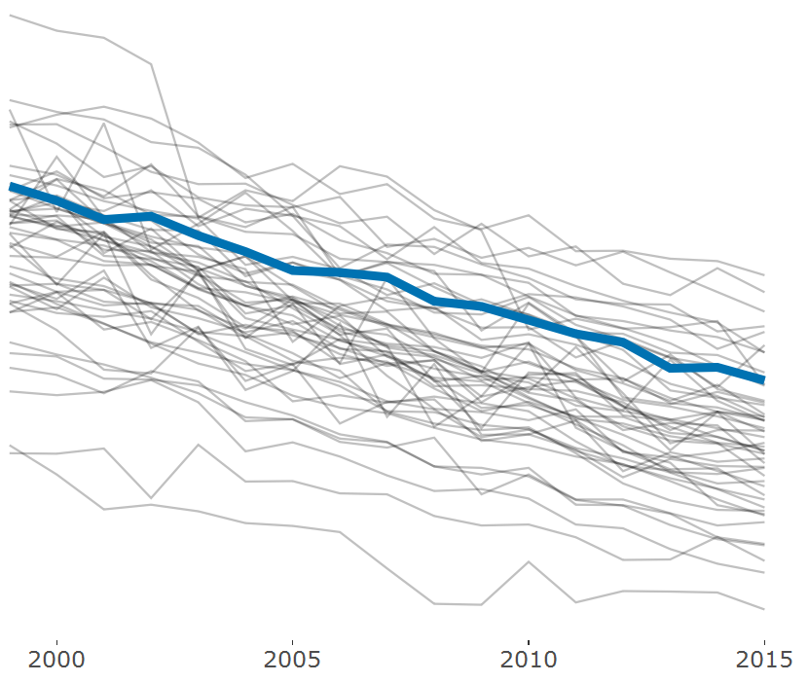

Mortality Rates Related to Cancer are Falling In Every State
When adjusting for age of the patient, Ohio has kept pace with the other states but consistently ranked among the top 15 states with the highest rates.
Age-Adjusted Mortalities Per 100,000 Residents
Ohio had the 11th highest rate in 2015.
Data Source: CDC Wonder Search Performed March 1st, 2017

